Slide 1
Lesson Review
Course: Android Basics: User Interface
Lesson: Building Layouts: Part 1
https://classroom.udacity.com/courses/ud834/

Slide 2
Views
User interface components are called “Views”
Basic building block for Android apps
Take a rectangular area of the screen
Draw (or write) something
Handle interaction (clicks)

Slide 3
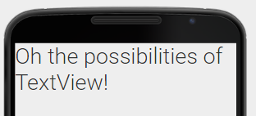
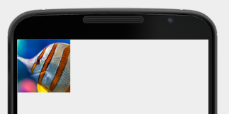
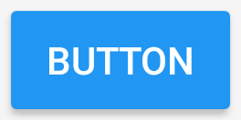
Types of Views
TextView
ImageView
Button
...and many more!
Notes:
On this lesson TextView and ImageView
Button will be later in the course

Slide 4
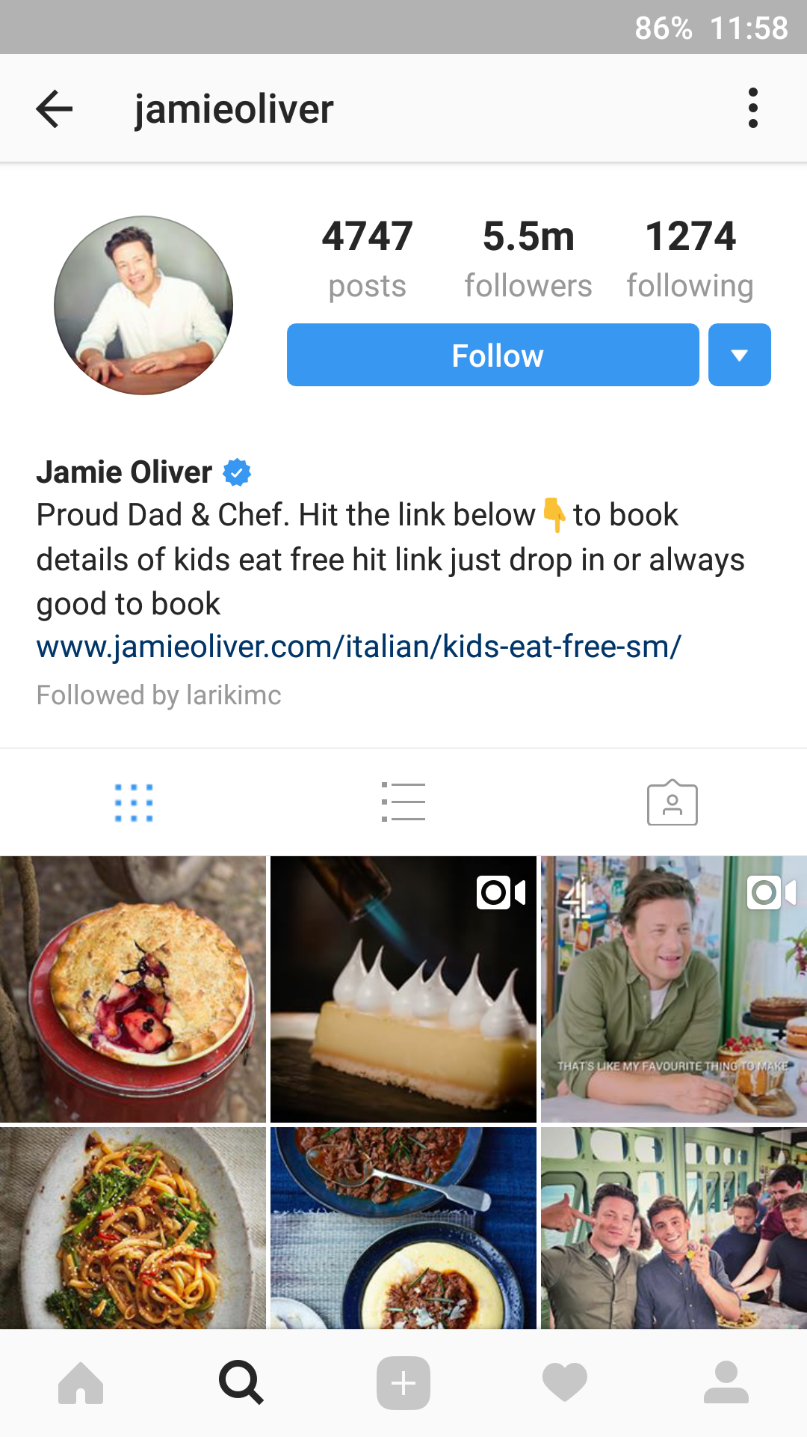
Identifying Views
Can you identify TextViews, ImageViews and Buttons on this screenshot?

Slide 5
Identifying Views
TextViews

Slide 6
Identifying Views
ImageViews

Slide 7
Identifying Views
Buttons

Slide 8
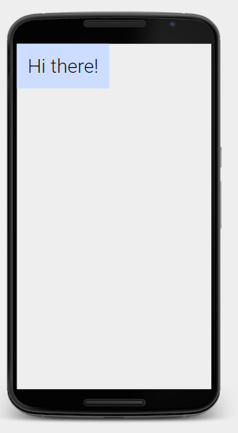
Using TextView
http://labs.udacity.com/android-visualizer/
<TextView android:text="Hi there!" android:layout_width="wrap_content" android:layout_height="wrap_content" android:textSize="36sp" android:fontFamily="sans-serif-light" android:textColor="@android:color/black" android:background="#ccddff" android:padding="20dp"/>
Notes:
Views are defined using XML language.
In XML, the different elements are contained within “tags” and contain multiple attributes.
This XML tag represents a TextView, and contain multiple attributes to define the text and the styling.
You can customize a View by changing its attributes.
Open the visualizer and copy the XML sample

Slide 9
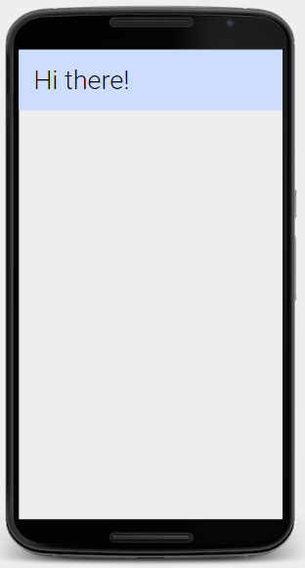
android:layout_width
http://labs.udacity.com/android-visualizer/
<TextView android:text="Hi there!" android:layout_width="match_parent" android:layout_height="wrap_content" android:textSize="36sp" android:fontFamily="sans-serif-light" android:textColor="@android:color/black" android:background="#ccddff" android:padding="20dp"/>
Notes:
layout_width and height are important attributes defined in Views
They define the size of the View, and if the view should expand to take all the available space or not
Open the visualizer and copy the XML sample
Change to 200dp and see what happens

Slide 10
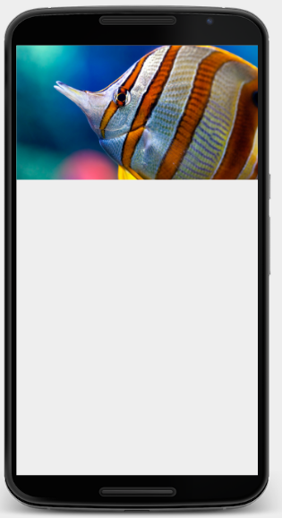
Using ImageView
http://labs.udacity.com/android-visualizer/
<ImageView android:src="@drawable/fish" android:scaleType="centerCrop" android:layout_width="match_parent" android:layout_height="200dp"/>
Notes:
ImageViews are also defined on XML, and the difference is that rather than defining a text attribute, they define an image (as src)
These images are referenced using the @drawable and references to an image inside your project. You will learn more about that on the Part 2 of the course.
Open the visualizer and copy the XML sample
Change the image src and see what happens

Slide 11
Homework (or to do now)
Building Layouts: Part 2
Practice Set 1 ← Installing Android Studio and create your first app!
Coffee Break Challenge ← Self evaluation quiz

Slide 12
To discuss with Coaches
Size: dp vs px vs sp
Image scale types?
Fonts on TextView? Bold? Italic?
How to read the official documentation or search answers online

